Slide 1

DES ALGORITHM
Data Encryption Standard

Slide 2
cryptography
Cryptography: Practice and Study of techniques for secure communication in insecure networks.
Uses mathematical techniques to encrypt and decrypt data.
Word “cryptography” is derived form Greek words ‘kryptos’ (hidden) and ‘graphein’ (write).
Cryptography is every where
In Secure Communications i.e, in web traffic (HTTPS) and wireless (GSM,Bluetooth).
For files on disk (EFS,TrueCrypt).
Content protection like DVD, Blueray (CSS,AACS)
…..and more.

Slide 3
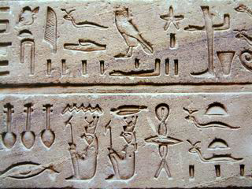
History
The first known evidence for Cryptography was found in an inscription carved around 1900 B.C in Egypt.
There are three eras in cryptography
Manual era
Mechanical era
Modern era

Slide 4
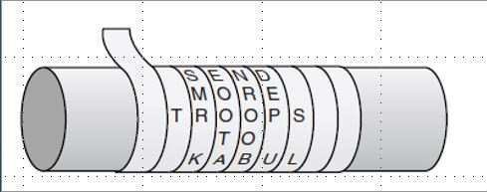
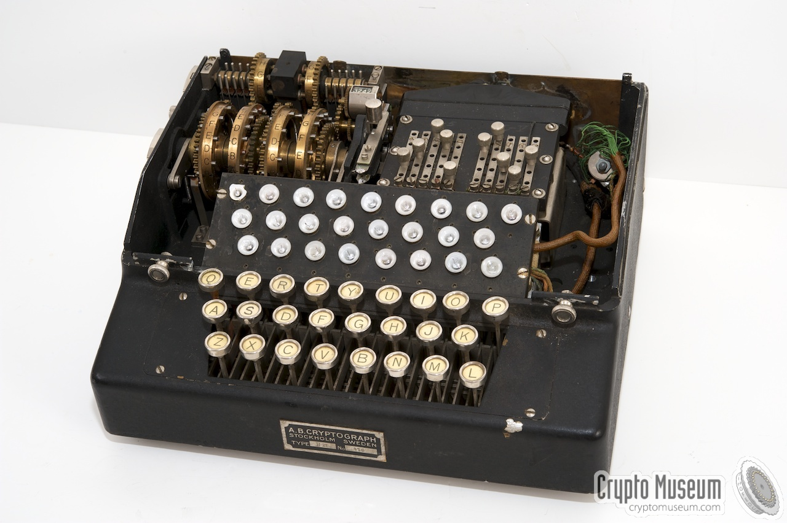
Manual Era:
In this era,there was only usage of pen and paper i.e,everything was done manually.
The first inscription also comes under this.
Later, there are many forms that came into existence like Scytale, Atbash, Caesar.
Mechanical Era:
Use of machines for encryption started in 18th century.
The machines made are Deisus Wadsworth(1817), Jefferson’s encryptor, and so on
Well reputed machine is Enigma(1920).
Modern Era:
This era of cryptography refers to computers.
There are large number of cryptosystems here like RSA, DES, AES and more.

Slide 5
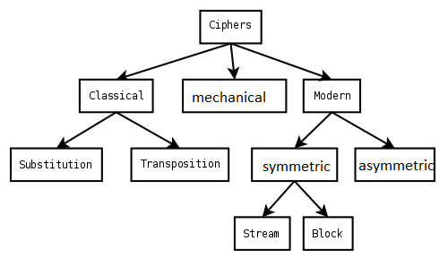
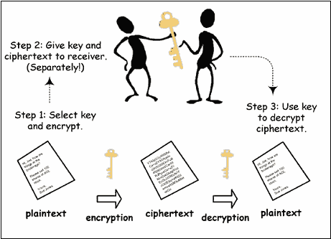
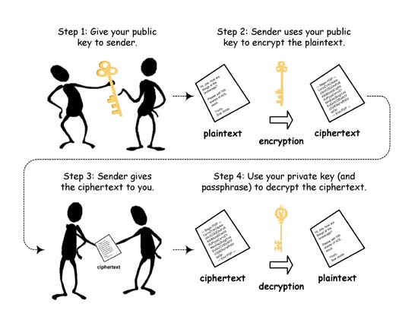
Types of cryptography
Symmetric :
Asymmetric:

Slide 6
des
In 1970’s,IBM created a crypto system called “Lucifer” for encryption of customers data.
In 1973, NIST made a proposal for national symmetric key cryptosystem.
IBM submitted Lucifer for validation.
Later on, changes were made by Walter Tuchman and that was accepted and called as DES.
DES is a symmetric block cipher, it encrypts 64 bits plain text with 64 bit key at a time .
The encryption process consists of three main parts
1. Initial and Final Permutation
2. 16 Feistel rounds
3. Key Generation

Slide 7
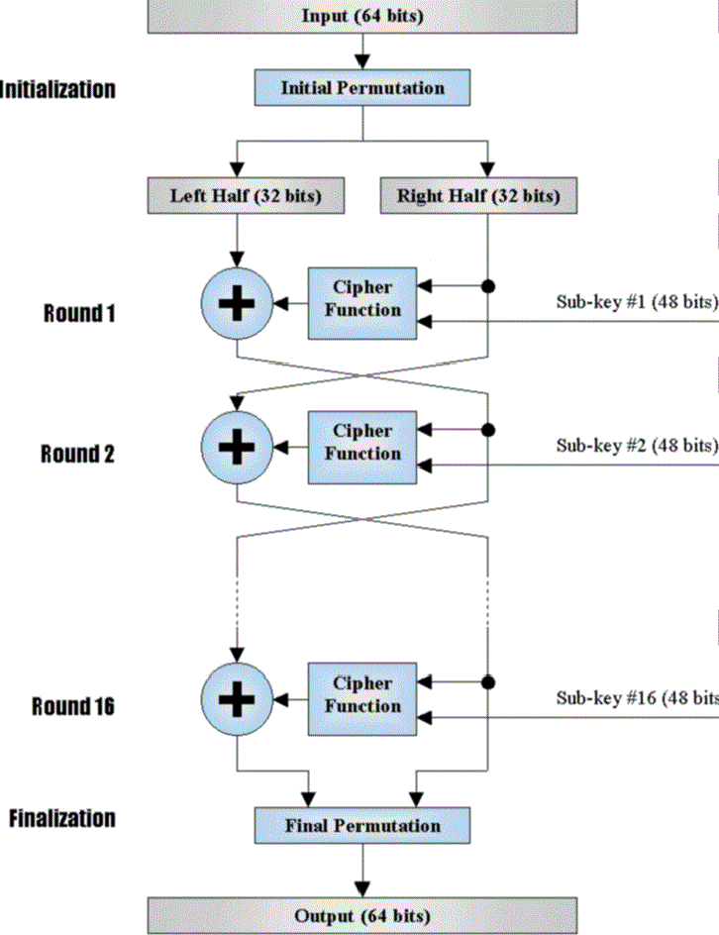
Des overview
Input goes into Initial permutation and then divided into two equal parts i.e,32 bits each.
Right half goes to feistel round with key and the result is XORed with Left half.
The output of XOR is then made as right half and right half before processing is considered as left half.
This process is repeated for 16 times.

Slide 8
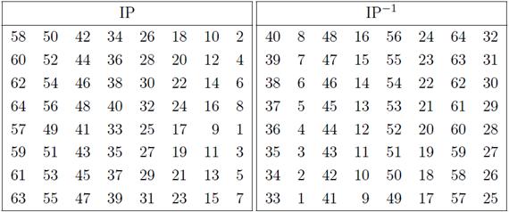
permutation
Permutation is about rearranging the bits in specified order.
Final Permutation is just the opposite of initial.
Pos | 1 | 2 | 3 |  | 50 |  | 58
Bit val | 1 | 0 | 1 |  | 1 |  | 0
Pos | 1 | 2 | 3 |  | 50 |  | 58
Bit Val | 0 | 1 | 42nd bit |  | 53rd bit |  | 55th bit

Slide 9
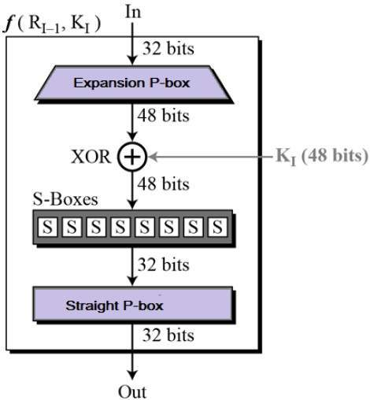
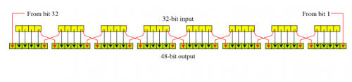
Feistel Round
Here the input is expanded and XORed with key and again compressed to its original size.
Expansion P-box:
Here the 32-bit input is expanded to 48-bit.

Slide 10
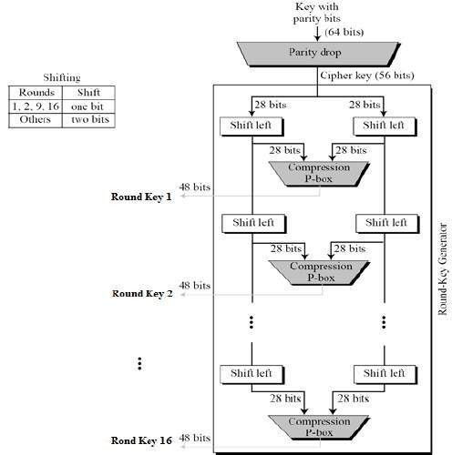
Key generation
Initially,Key is of 64 bits later on,it goes through parity dropper where it becomes 56.
It is divided into two parts and left shift operation is done using the key timer.
Later,It goes through compression P-box and it is compressed to 48-bit.
Eventually,16 keys are generated and are saved for each fiestel round.

Slide 11
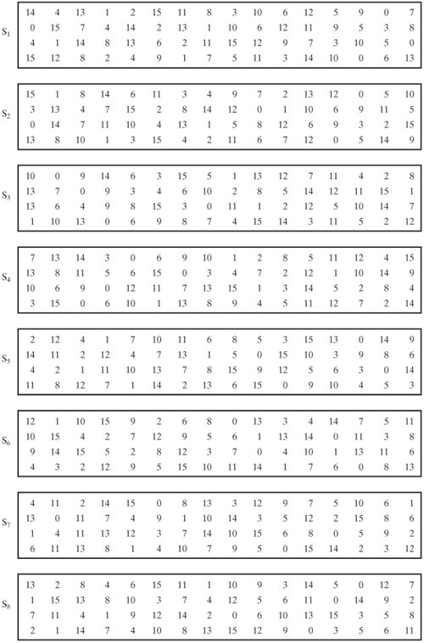
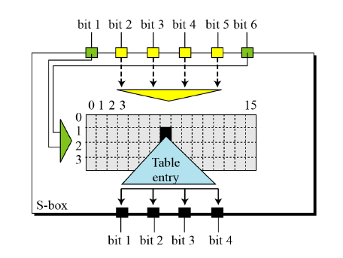
S-Boxes
Substitution Boxes are used to compress the 48-bit output from XOR in feistel round to 32-bit.
There are 8 s-boxes, each takes 6 bits and gives 4 bits.
For ex: 111000 the row value is ‘10’ that is 3 and column value is‘1100’ is 10, so the output will be 9(1001).

Slide 12
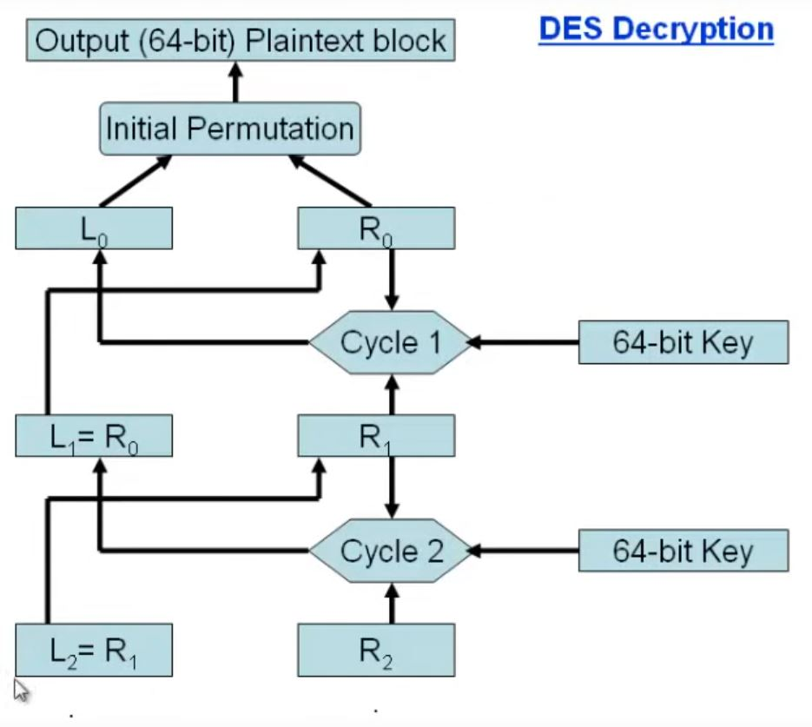
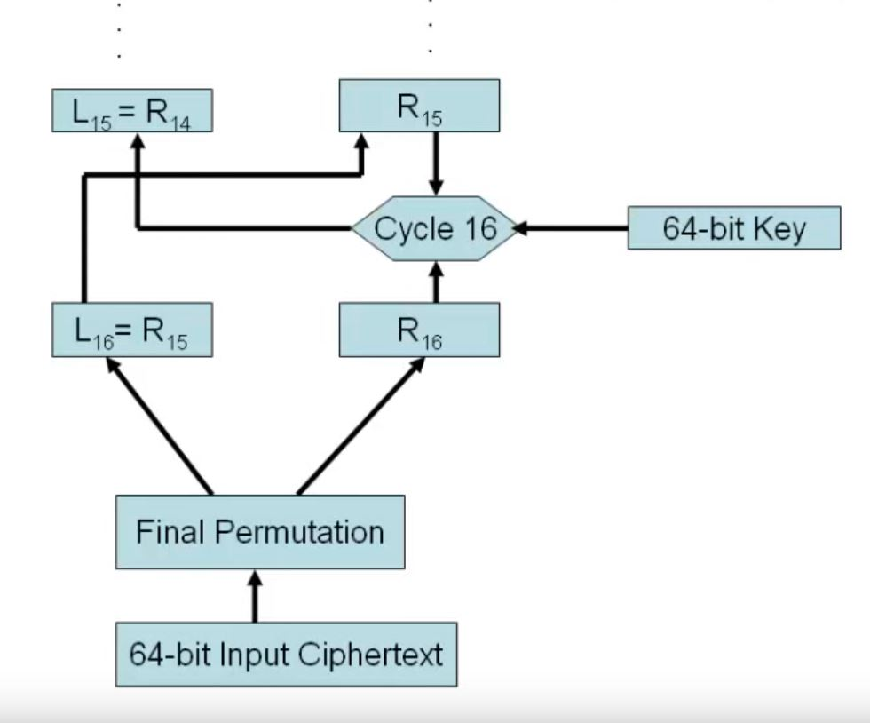
decryption
This is exactly the reverse functioning of Encryption.
Here the stored keys are used in reverse order
Final Permutation will be initial and vise-versa.

Slide 13
Breaking des
Brute force Search , which seems impossible. But it was proven wrong
. In 1997, on a large network of computers in a few months
. In 1998, on dedicated h/w in a few days
. In 1999, it was done in 22 hrs
DES also broken theoretically by Differential or Linear Cryptanalysis.

Slide 14
Implementation
Will walk through code and come back!!!!

Slide 15

Advantages
DES exhibits a strong avalanche effect.
DES is not a group cipher hence their instances can be applied many times to a plaintext(2DES,3DES).
Each bit of ciphertext depends upon multiple bits of plaintext.
disAdvantages
Earlier, It was impossible to break DES but in this age of parallel computing, breaking it has become easy with the help of brute force attack.
The purpose of the initial and final permutation is not clear.
Two chosen inputs to the s-box can give the same output.

Slide 16
conclusion
The whole history of cryptography is filled with cryptographers creating unbreakable ciphers and cryptanalysts breaking them.
In the very same way DES was made, used and broke.
Now DES was braked, Triple DES was slow. What next?
Here the existence of AES came into picture.

Slide 17
References
https://kl2217.wordpress.com/2010/11/23/cipher-types/
http://cryptowiki.net/index.php?title=Classical_cryptography:_experience_and_lessons
All images used are from : google.com

Slide 18

Sai Aditya Ravi
Rahul Kakarla
Shyam Madhukuri
Manisha Upadhrasta

